Slide 1


California
Department of Insurance
Durriya Syed
Northern CA Outreach Analyst
Community Relations & Outreach Branch

Slide 2

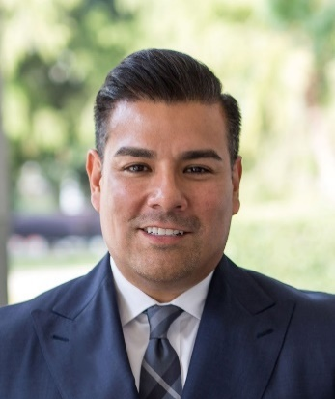

ROLE OF INSURANCE COMMISSIONER
Protect Consumers
Maintain Insurer Solvency
Perform market conduct reviews
Set standards for agents and broker licensing
Resolve consumer complaints
Investigate and prosecute insurance fraud
Enforce the insurance laws of California

Slide 3
The Insurance Market
Inflation is creating unprecedented financial stress to insurance markets.
Increased costs of rebuilding, supplies, materials, labor shortages, among other costs, are affecting insurance markets.
As risk grows, insurance markets are contracting to protect solvency, meet financial obligations and regulatory mandates.
Natural disasters & global inflation have increased insured losses and costs worldwide like never before.

Slide 4
California Context
Top 12 Companies =
85% of State’s Homeowners Market
The property insurance market in the country (specifically in large states like California) is changing quickly.
Since 2022 alone — 7 of top 12 insurance companies have paused or restricted new business despite rate increases approved or pending with Department of Insurance.

Slide 5
How did we get here?
FAIR Plan has increased to 3% of CA market – becoming the insurer of first resort, not last resort, for many.
Insurance companies will not write in high-risk areas unless they can cover 100% of consumer claims, their expenses, and earn a fair return.

Slide 6
Safer From Wildfires
Protect your home or business
+
Protect the immediate surroundings
+
Protect the whole community

Slide 7
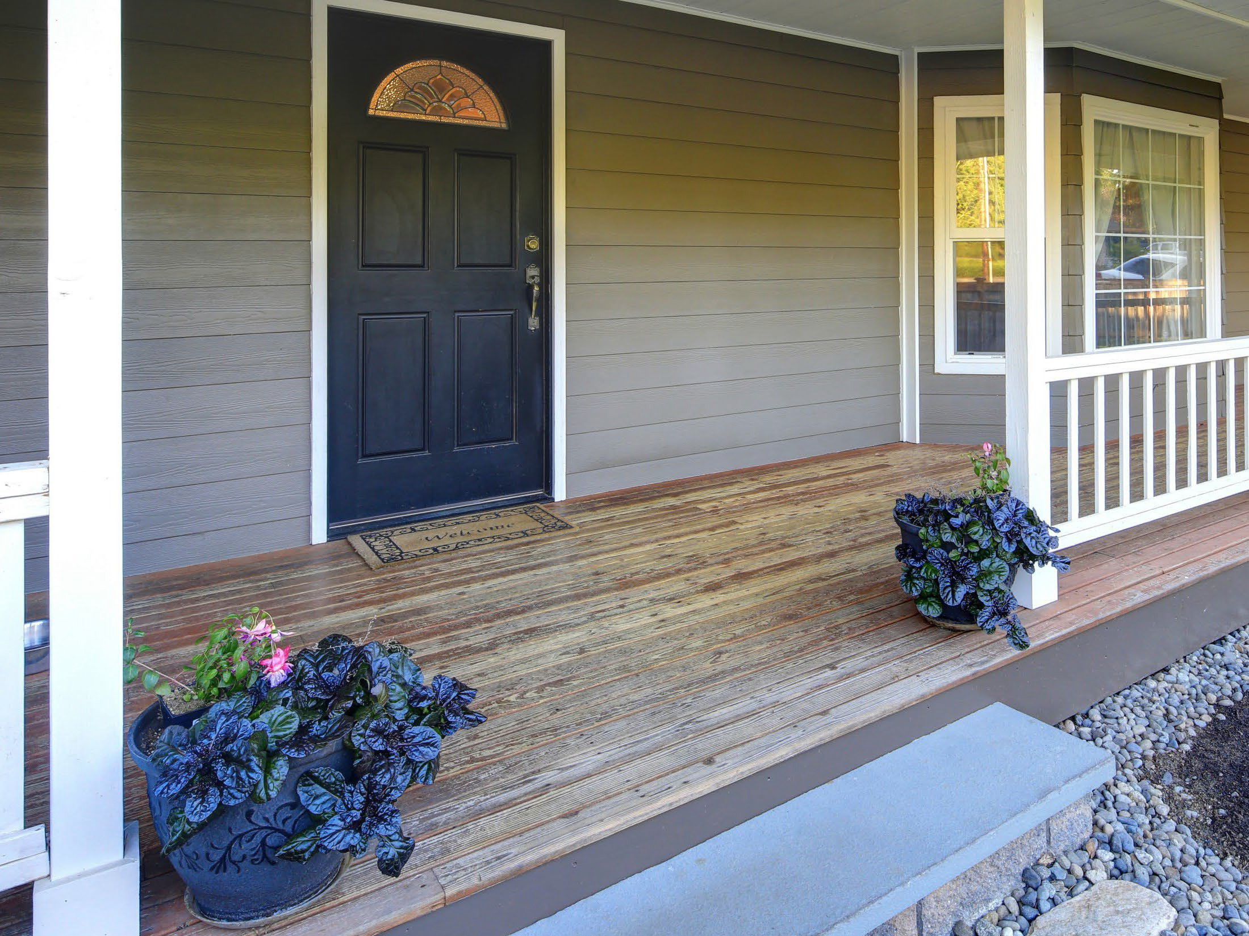
Protect your
home or business
Class A fire-rated roof
5-foot ember-resistant zone around the structure
Noncombustible 6 inches at the bottom
Ember- and fire-resistant vents
Double pane windows or added shutters
Enclosed eaves
of walls

Slide 8
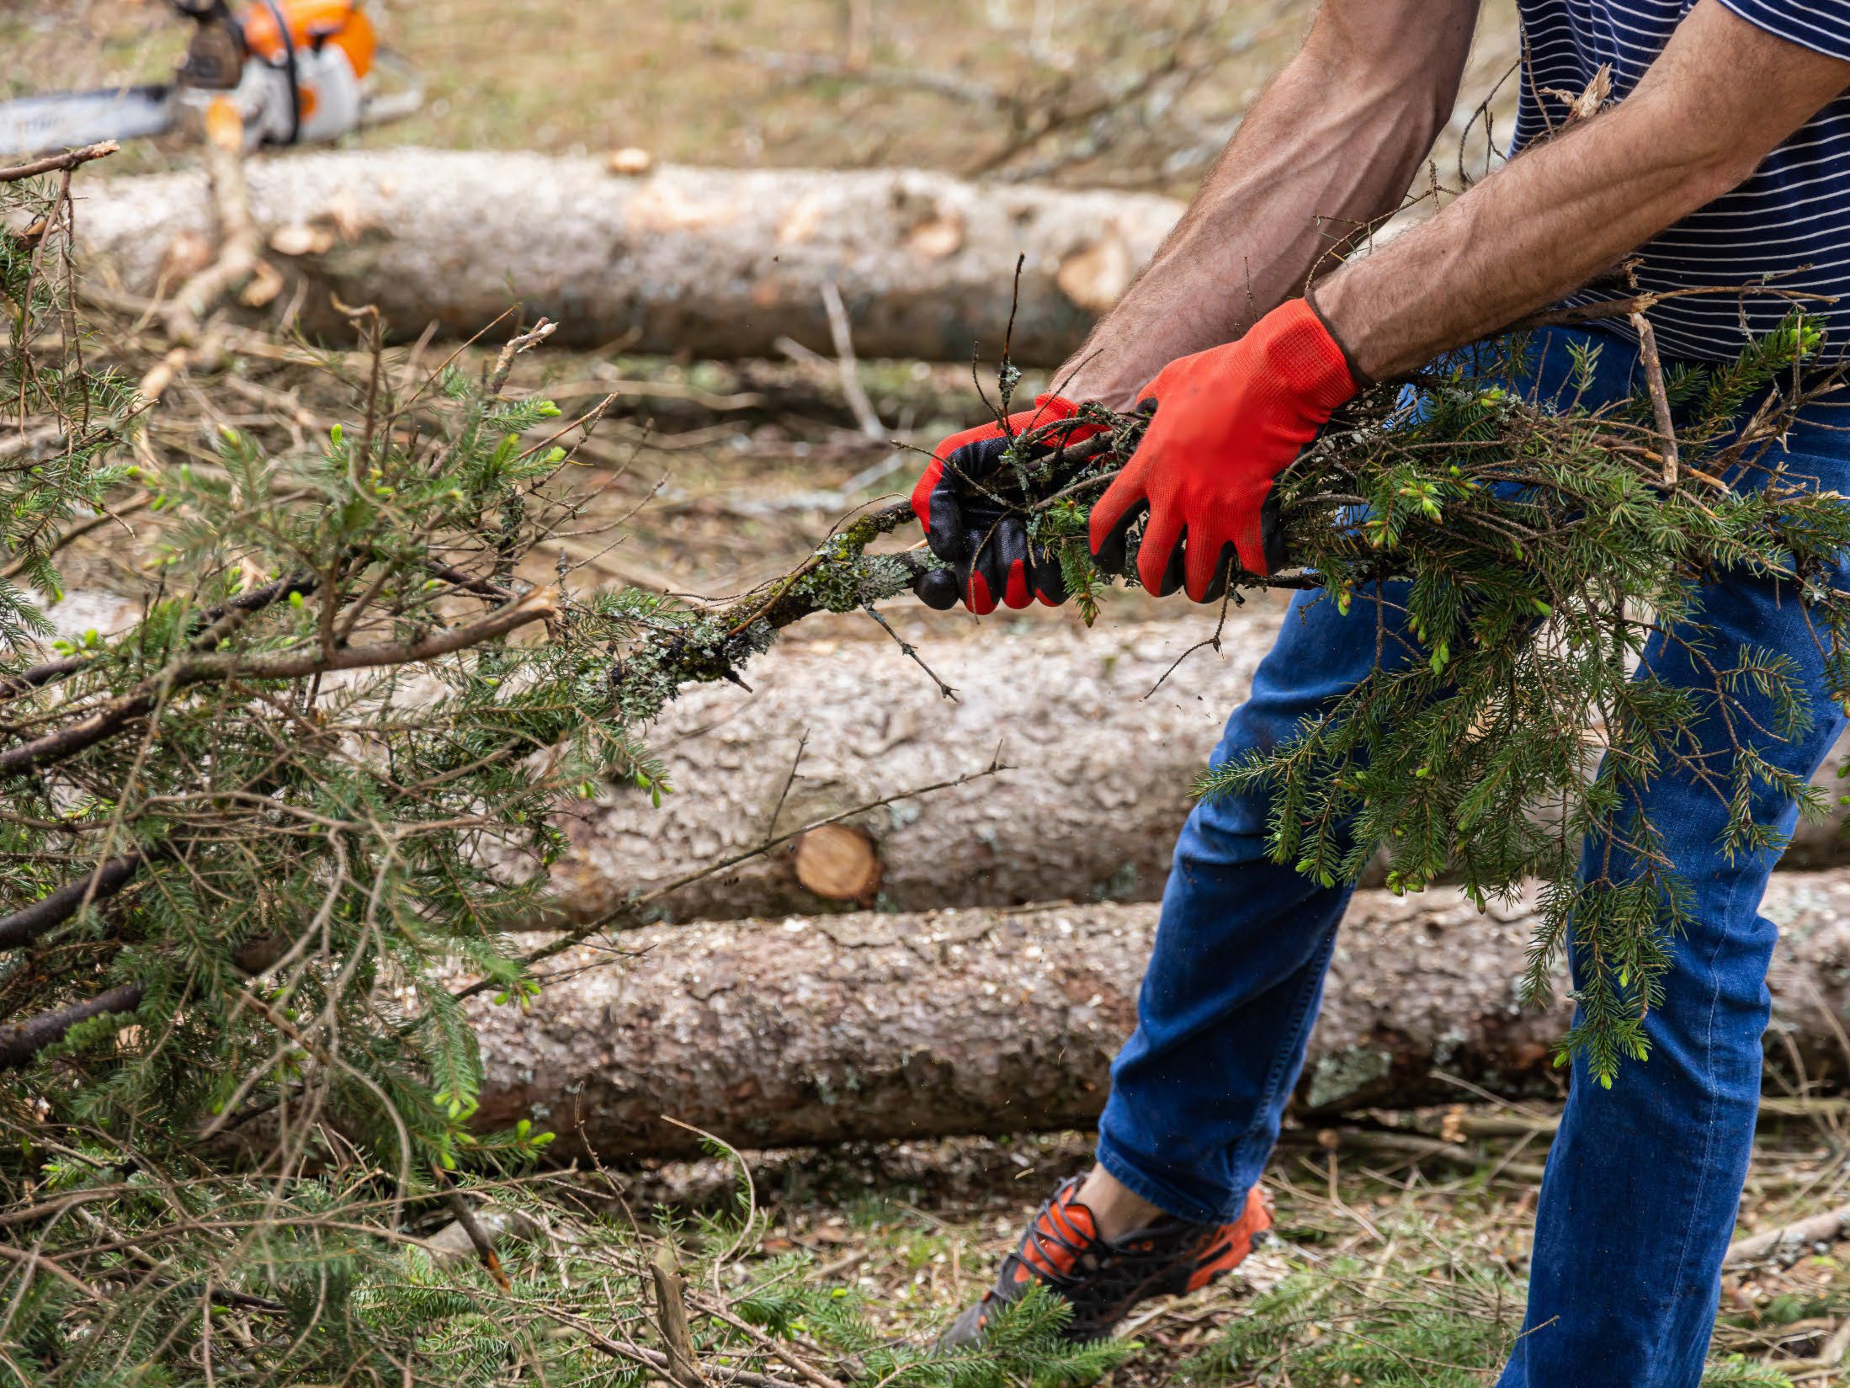
Protect the
immediate surroundings
Cleared vegetation and debris from under
Move sheds and outbuildings at least 30 feet away
Trim trees and remove brush in compliance with state and local defensible space laws
decks

Slide 9
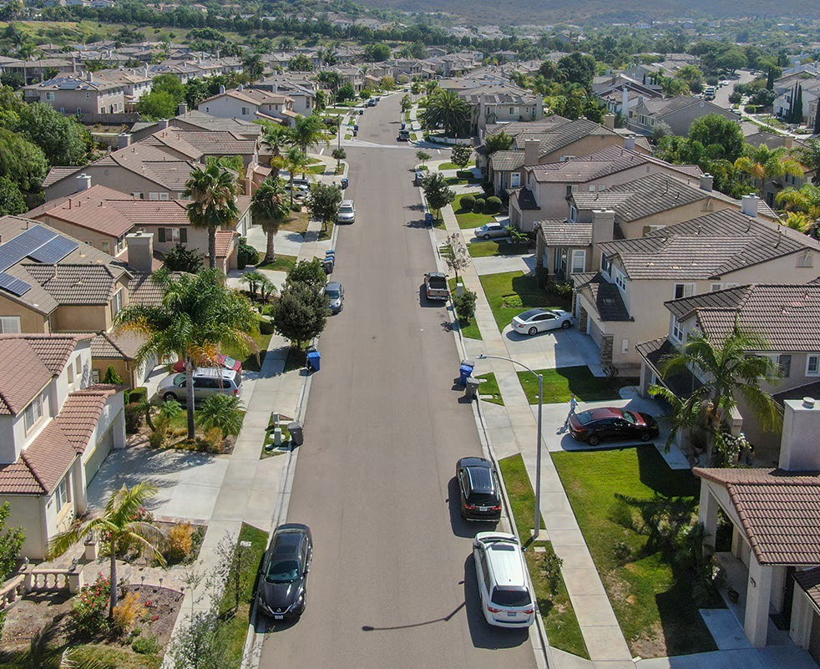
Protect the
whole community
•
•
Neighborhoods can form a Firewise USA community
Cities, counties, and local districts can become certified as a Fire Risk Reduction Community

Slide 10
CA FAIR Plan & Wildfire Risk Score
In August 2023, the CA FAIR Plan began offering insurance discounts
The CA FAIR Plan is offering 20 million dollar coverage per location for commercial policies, including HOAs
Wildfire Risk Score - regulation allows consumers to request and appeal their property risk score

Slide 11
California Sustainable Insurance Strategy
Insurance Availability in At-Risk Areas — Requiring insurance companies to write no less than 85% of homes and businesses in distressed areas identified by the Insurance Commissioner.
Returning FAIR Plan Policyholders to Market — With first priority given to homes and businesses following “Safer from Wildfires” regulation.
Cat Models/Mitigation — New models will recognize mitigation and hardening requirements to appropriately price rates and discount benefits; presently not available in current rate making process today.
California-only reinsurance costs — Protecting consumers from paying for other global catastrophes.
Modernizing FAIR Plan — Expanding commercial coverage limits to $20 million per structure closes coverage gaps for many.

Slide 12
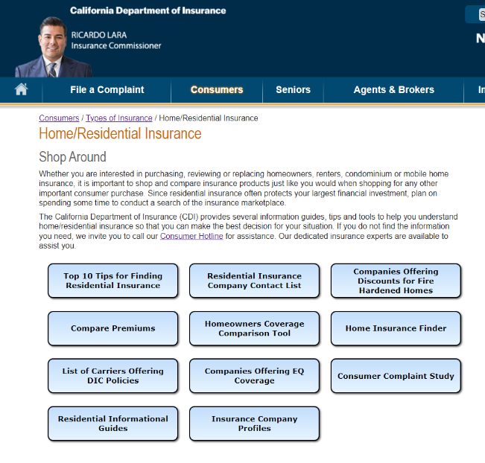
Online Tools Available at
insurance.ca.gov
Top Ten Tips
Insurance Finder Tool

Slide 13
Getting Help
Visit website at www.insurance.ca.gov
File a Complaint
Consumer Hotline: 1-800-927-4357 or Consumer Live Chat via website

